Slide 1



Passion Pursuit
Dr . D.Y.PATIL PRATISHTHAN’S
Institute For Advanced Computing & Software Development (IIACSD) Akurdi Pune.
Group No : 58
PRESENTED BY
Aniket Gadage Roll No. 233130
Rohit Narahare Roll No. 233171
MENTORED BY
Prof. Mrs. Geeta Darunte

Slide 2
CONTENTS
INTRODUCTION
PROBLEM STATEMENT
OBJECTIVE
PLAN OF METHODOLOGY
FEATURE SCOPE AND EVALUATION
FEATURE SCOPE
7. CONCLUSION
8. REFERENCES

Slide 3
INTRODUCTION
In a rapidly evolving world where technology has become a cornerstone of daily life, the "Passion Pursuit" project emerges as a dynamic and innovative solution. This project is dedicated to creating a service-oriented platform that facilitates meaningful connections between consumers and small businesses operating in diverse sectors such as Arts, Entertainment, Music, Cooking, Fitness, Sports, and Recreation.
By harnessing the power of digital connectivity, the Passion Pursuit platform aims to bridge the gap between individuals seeking unique experiences and services, and the creative entrepreneurs who passionately craft and provide them.

Slide 4
PROBLEM STATEMENT
In today's fast-paced digital landscape, the individuals and the unique offerings of small businesses within the Arts, Entertainment, Music, Cooking, Fitness, Sports, and Recreation sectors often struggle to find creative pursuits of a platform where they can effectively connect.
Consumers who seek to explore new hobbies, learn from experts, and engage with like-minded individuals encounter difficulties in finding a consolidated space that provides inspiration, resources, and genuine interactions.

Slide 5
Objective
A service-oriented platform focuses on establishing and maintaining connections between consumers and small businesses in the Arts, Entertainment, Music, Cooking, Fitness, Sports, and Recreation sectors.
Small businesses can use the app to showcase their products or services and create highlight videos from photos of their personal projects.
Users can create themed collections within the app to categorize their projects. These collections can be based on different hobbies such as gardening, cooking, arts and crafts, fitness, decoration, and more.

Slide 6
PLAN OF OBJECT METHODOLOGY
Making of front end.
Creating various table in database as needed.
Connection of front end to back end (connection of forms to database).
Updating of Business detail by Business Owner.
Doing respective jobs.

Slide 7
Technology
❖ Spring-Boot :
The main goal of the Spring Boot framework is to reduce overall development time and increase
efficiency. React has become the first choice for frontend because it gives developers the ability to
work with a virtual browser (more friendly than the real browser). Also, a JavaScript developer can
become a productive developer in a few hours because there is a small API to learn, a few functions,
and how to use them.
❖ React :
React allows developers to create large web applications that can change data, without reloading the
page. The main purpose of React is to be fast, scalable, and simple.
❖ MySql Database :
MySQL is globally renowned for being the most secure and reliable database management system
used in popular web applications
MySql supports relational data to store in tabular format. so that we can access it very easily.

Slide 8
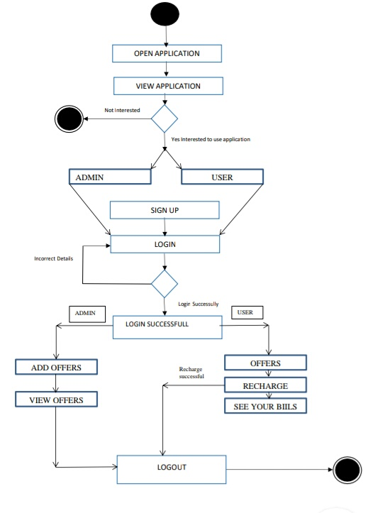
DFD

Slide 9
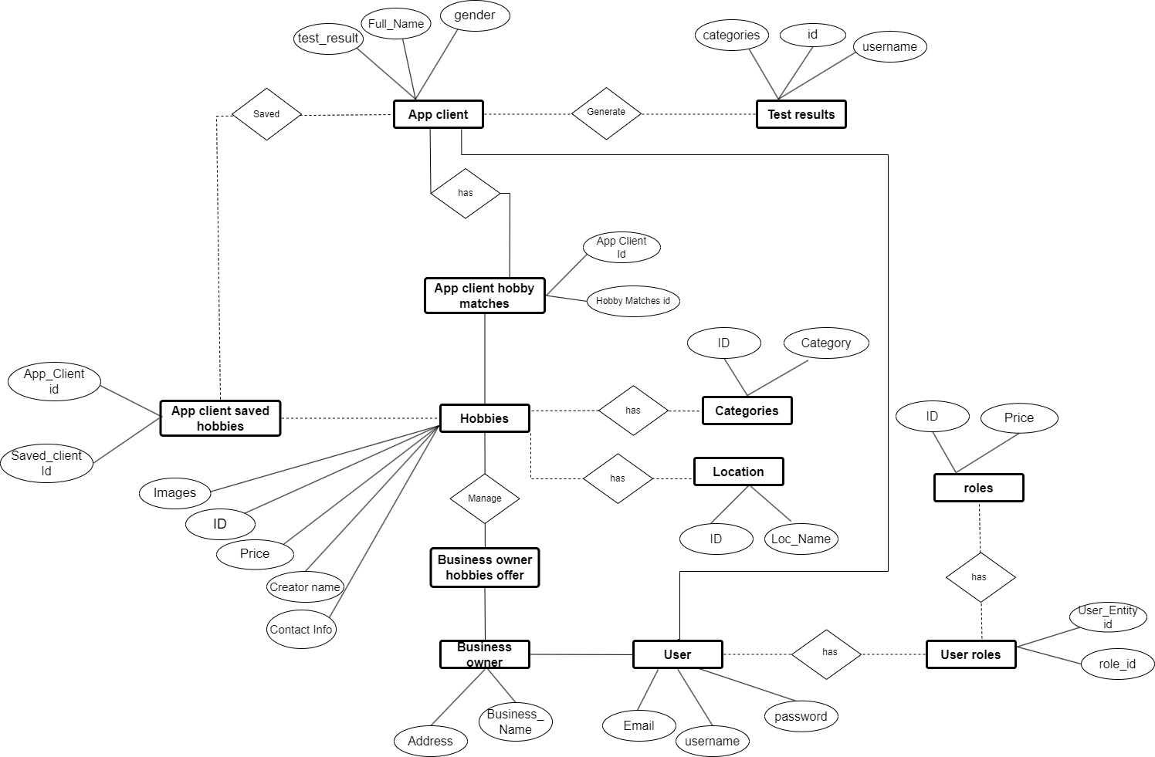
Fig-System Diagram

Slide 10
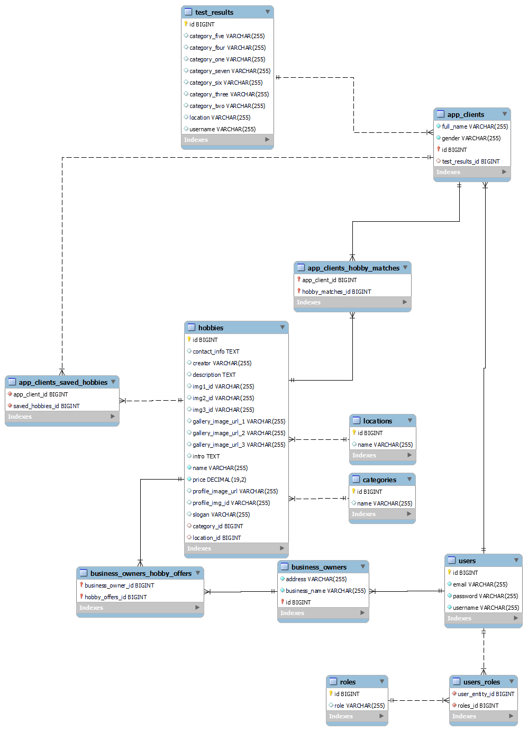
Figure:-E-R Diagram

Slide 11
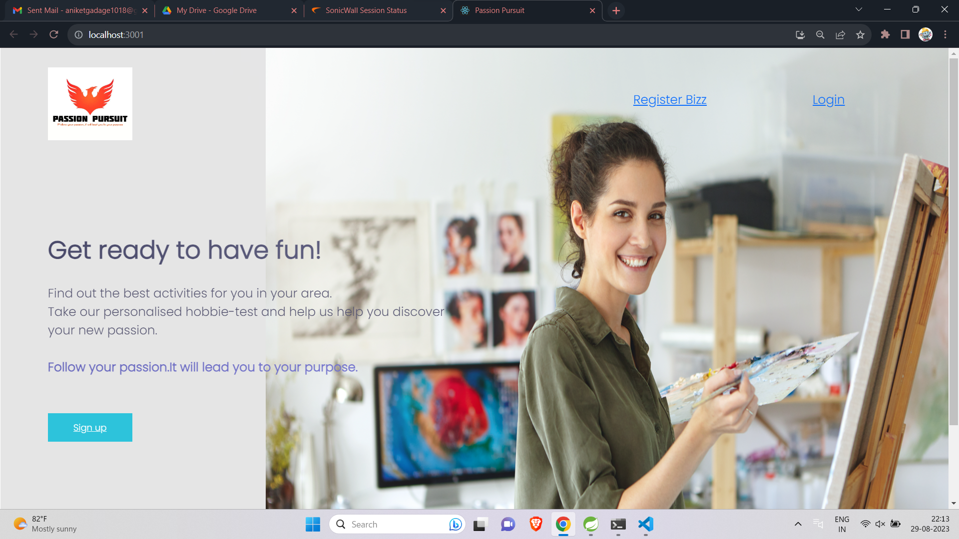

Slide 12
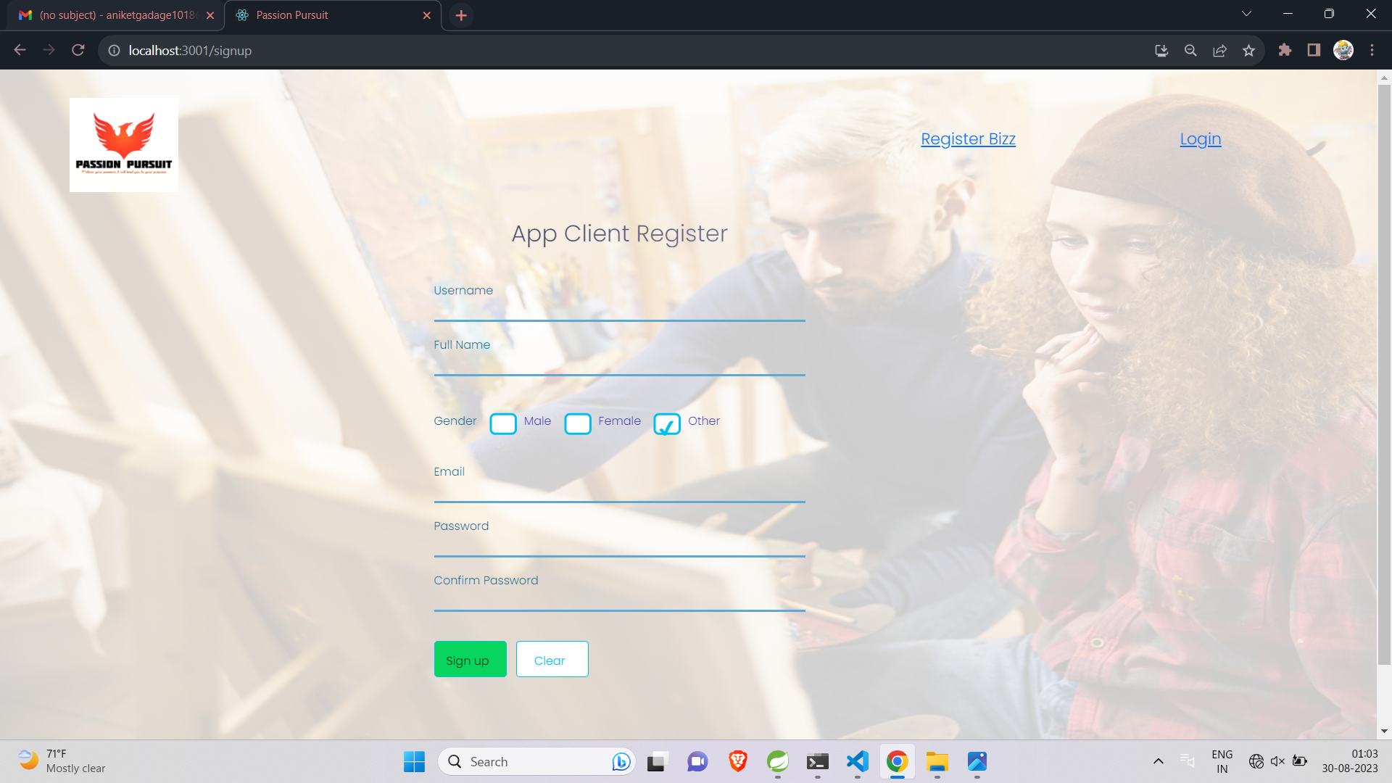

Slide 13
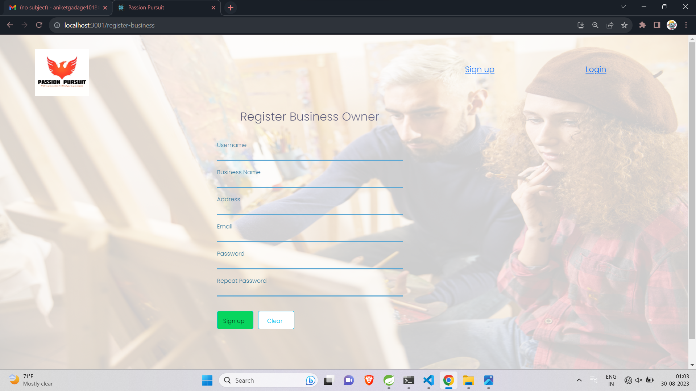

Slide 14
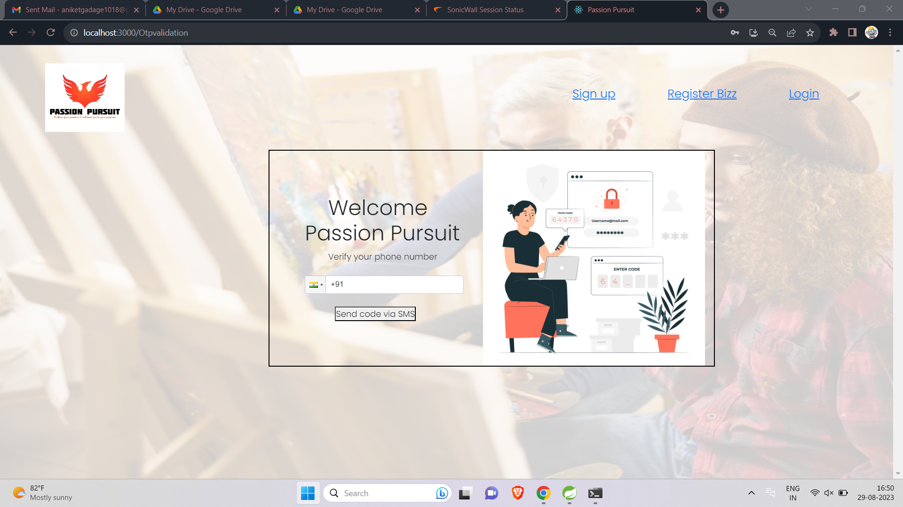

Slide 15
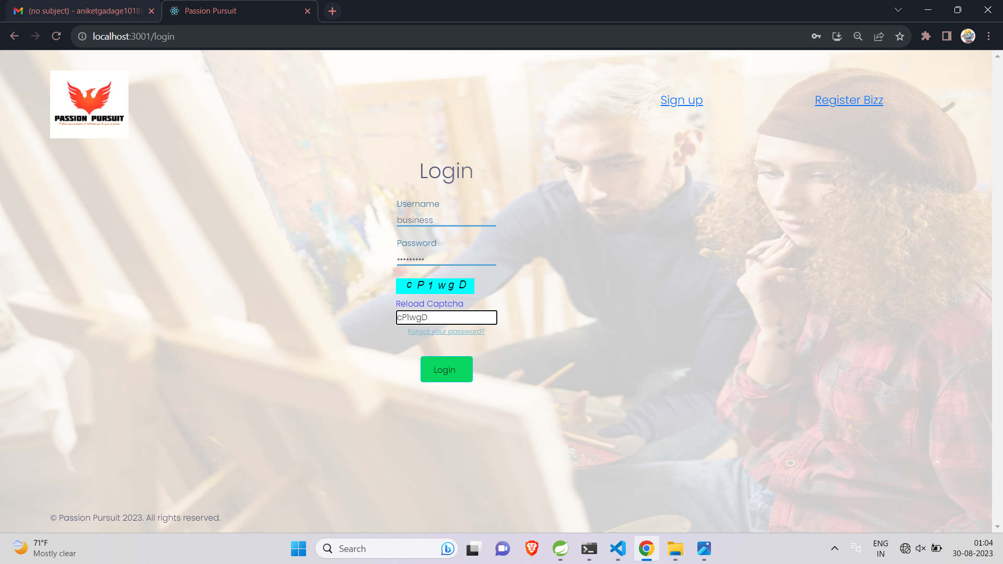

Slide 16
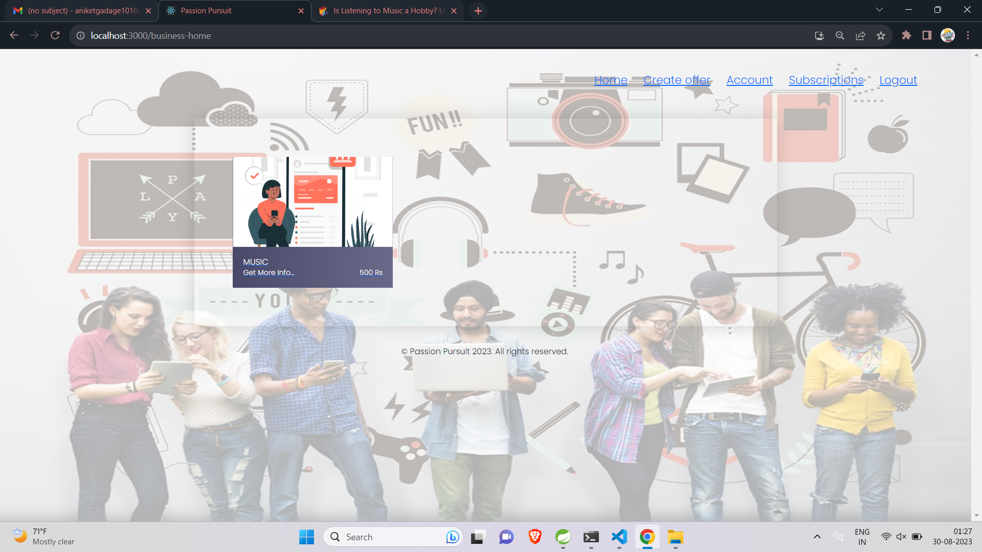

Slide 17
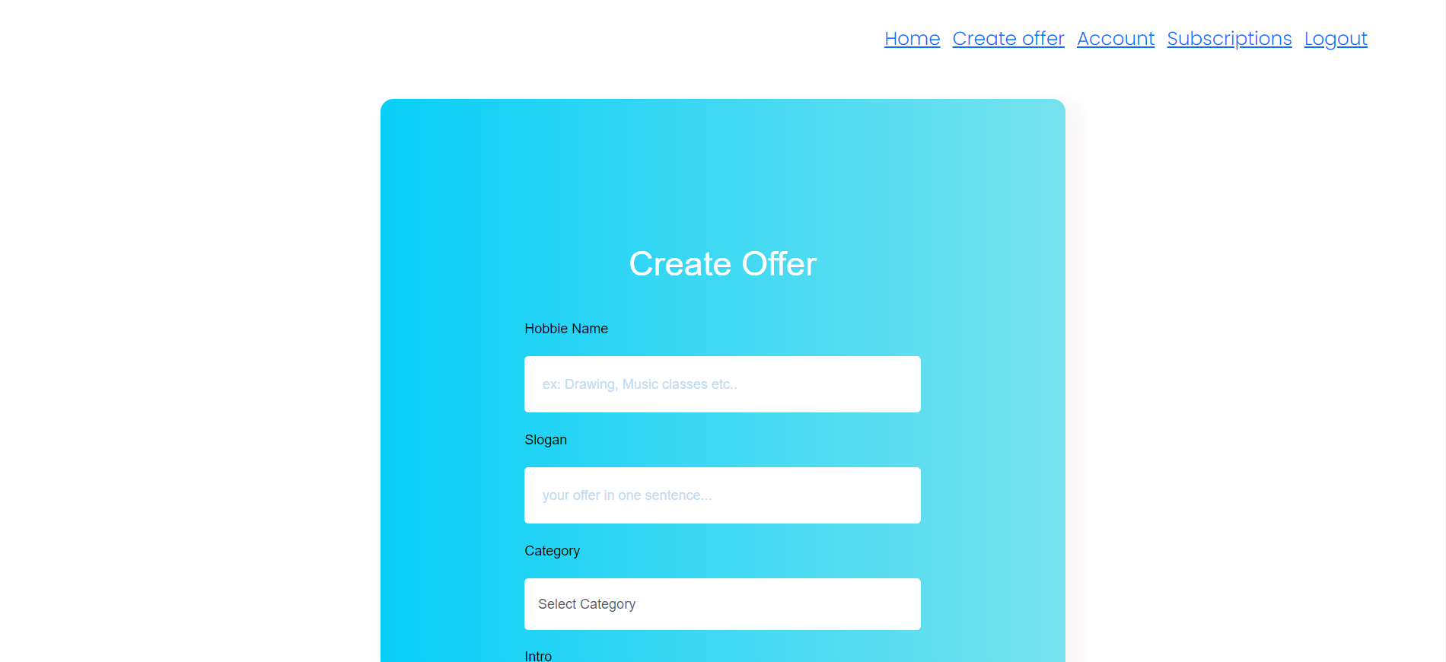

Slide 18
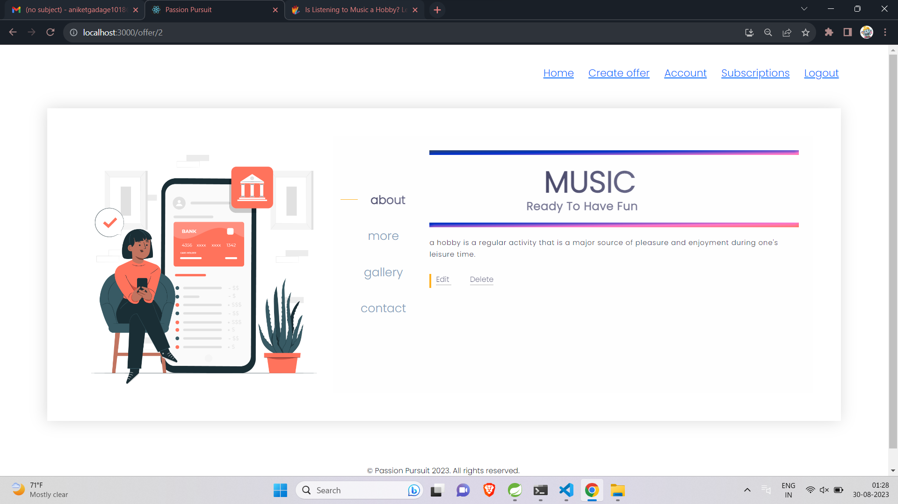

Slide 19
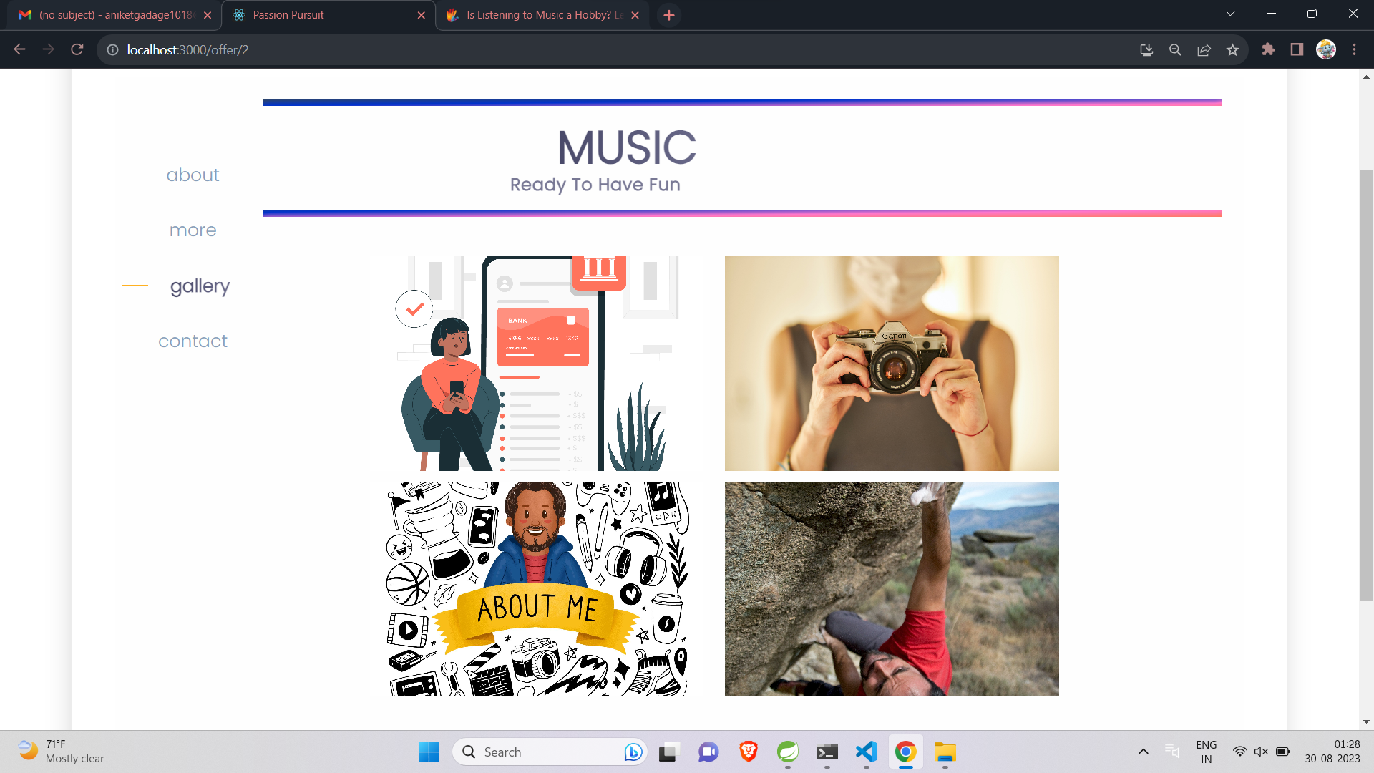

Slide 20
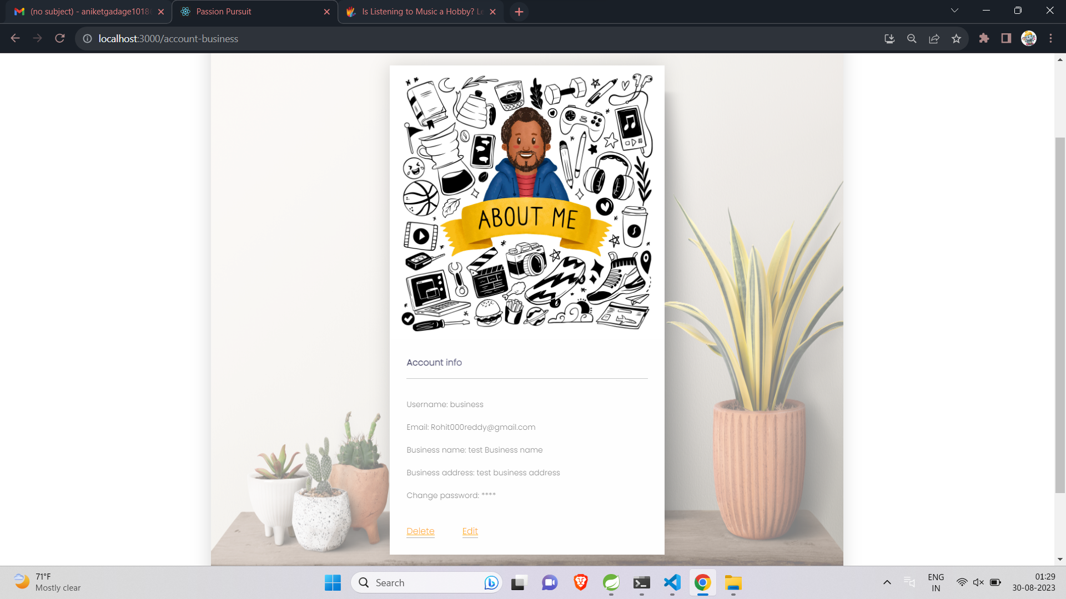

Slide 21
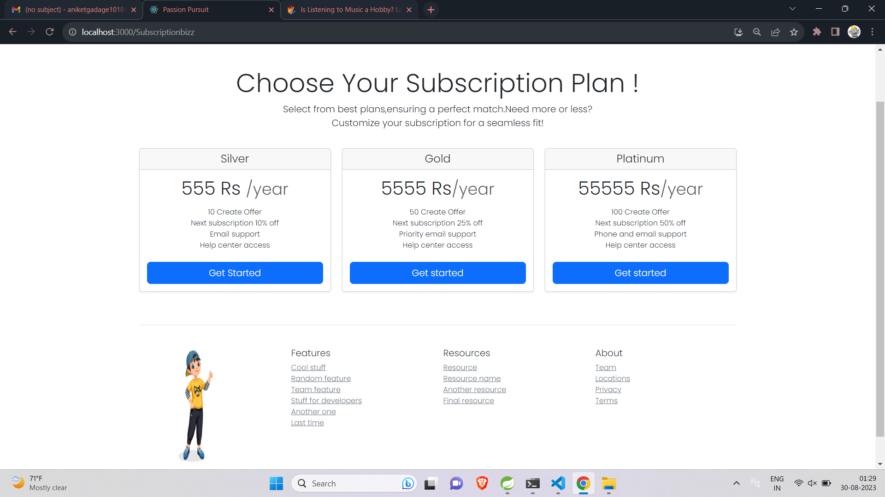

Slide 22
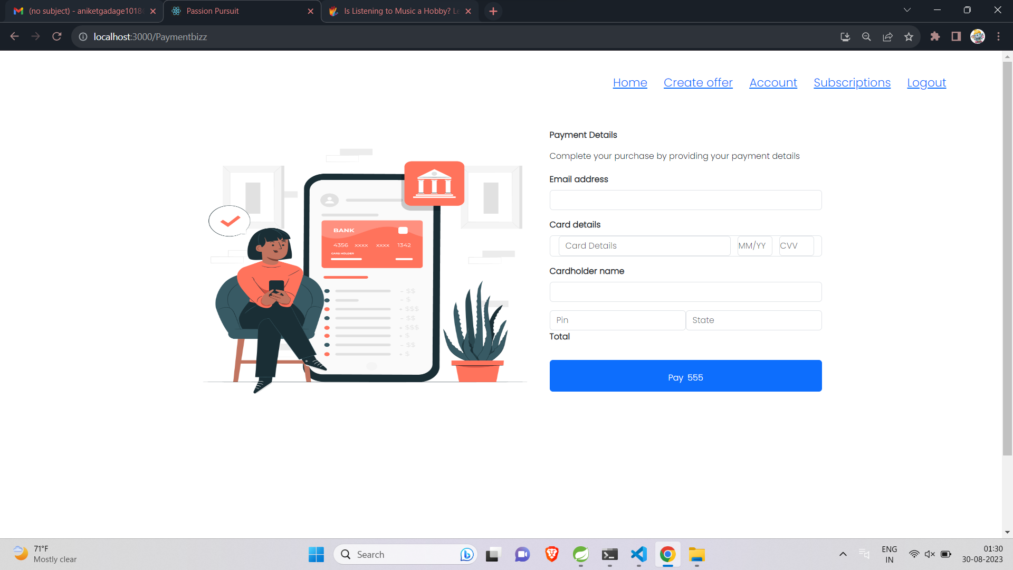

Slide 23
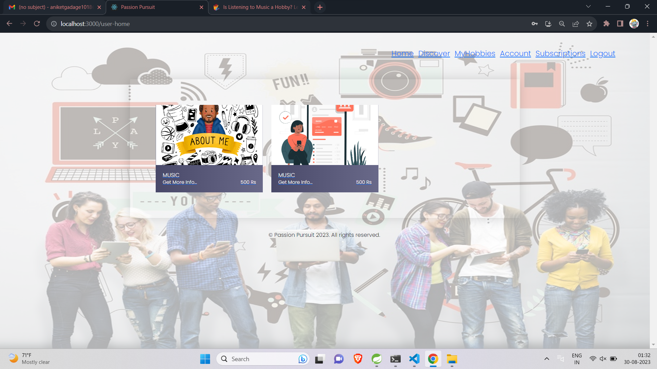

Slide 24
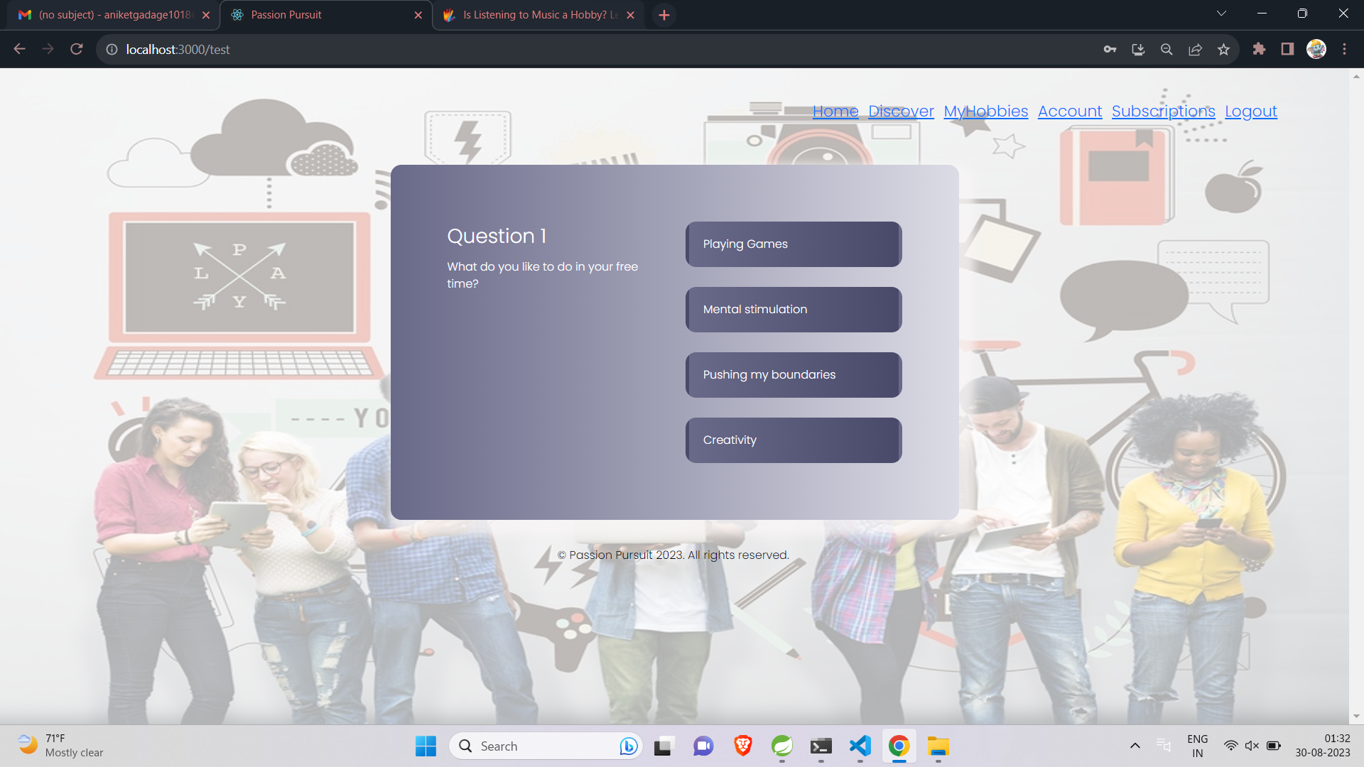

Slide 25
MEASURES OF UNIQUENESS
It is very unique compared to other websites because in this we cover all the all hobbbies. Other websites only select famous games and sports.
This web application we are providing best service who are giving best service and supports small business.
Our customers can choice his/her hobby and follow their passion.

Slide 26
FUTURE SCOPE AND EVALUATION
Any business can make use of it for saving customer details in database.
User and business owner can communicate throw our chat bot.
This application can easily implemented under various situations.
We can add new features as and when we require.

Slide 27
FUTURE SCOPE
We will include more functionality as per the user requirements.
We want to improved our home page, as it is the main things which attracts all user.
Not a single website is ever consider as complete forever firstly because there is always something new requirements also are growing day by day

Slide 28
CONCLUSION
The Passion Pursuit project aims to bridge the gap between consumers and small businesses in various sectors by providing a service-oriented platform. By allowing users to categorize and showcase their projects based on their hobbies and interests, and enabling business owners to manage their profiles and events, the platform fosters engagement and connections. Through secure login mechanisms and user-friendly interfaces, the project aims to deliver a seamless experience to users and business owners alike, promoting a thriving ecosystem of creativity, passion, and entrepreneurship in the Arts, Entertainment, Music, Cooking, Fitness, Sports, and Recreation sectors.

Slide 29
REFERENCES
https://cloudinary.com/
https://firebase.google.com/
https://legacy.reactjs.org/
https://react-bootstrap.netlify.app/

Slide 30


THANK YOU

